Slide 1
Special Lab Session
Objectives:
Team activities: You’re a team with 5 members configuring on one machine
Install and configure DNS Server using BIND9
Install and configure Web Server using Nginx
Free to use materials online
Support materials:
https://ubuntu.com/server/docs/service-domain-name-service-dns
https://ubuntu.com/tutorials/install-and-configure-nginx#1-overview
Rewards:
Coupons for one Coursera account of 6 months period.

Slide 2
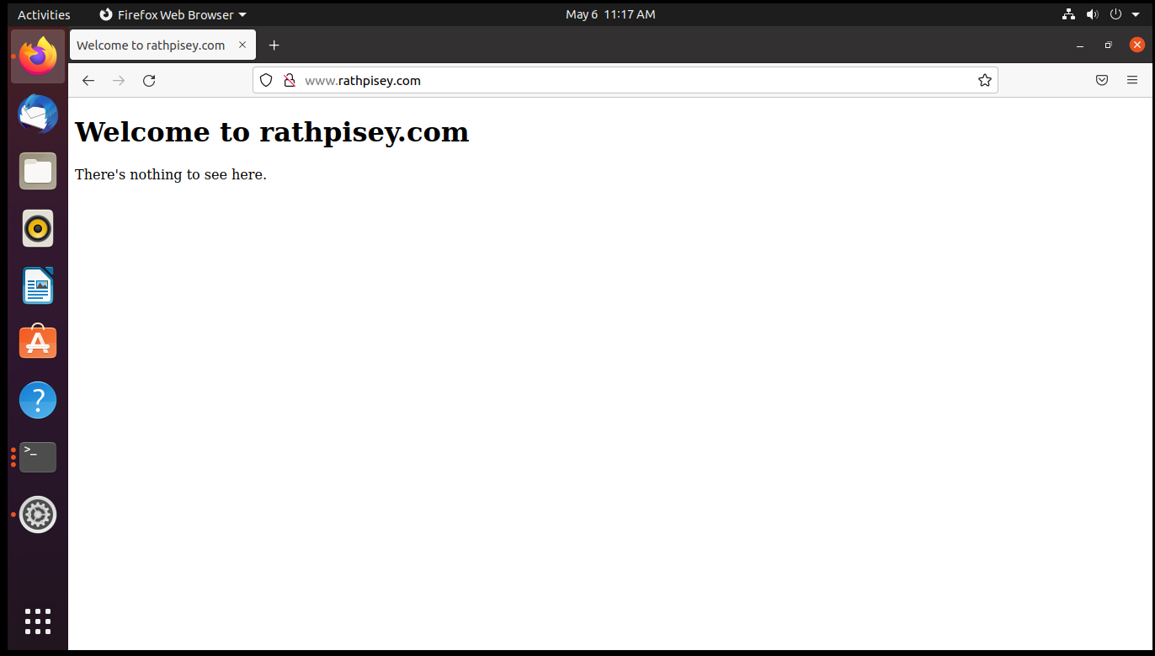
Special Lab Session
Result:

